Slide 1
INFO-1156 Object-Oriented Programming with C++
Project 1 - Introduction

Slide 2
Beginning a Project
Read handout and read the rubric.
Run the executable to discover behaviours and error messages based on certain inputs.
What is acceptable input? What is unacceptable?
What happens if input is unacceptable?
Make a list of all possible test data!
Match your program to the executable.

Slide 3
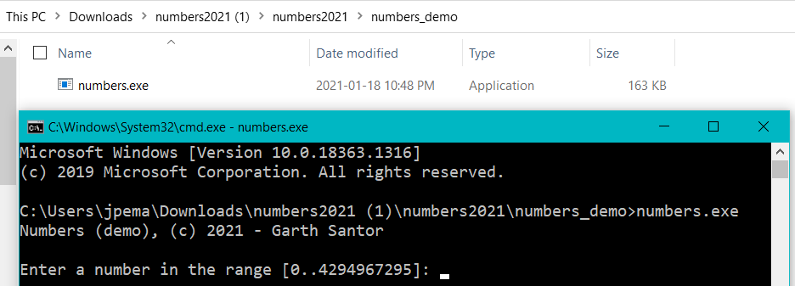
Test using: numbers.exe
Download the zip file from the Project folder
Unzip, double click to execute
Enter various input that will test the project requirements

Slide 4
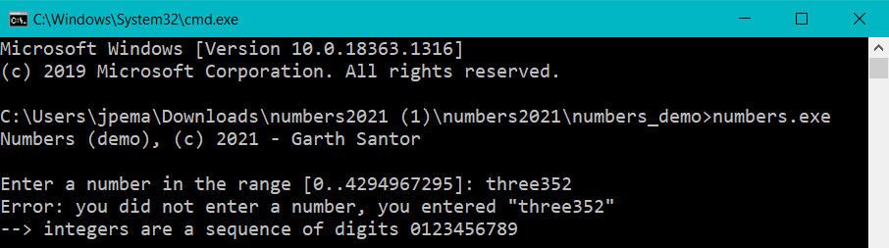
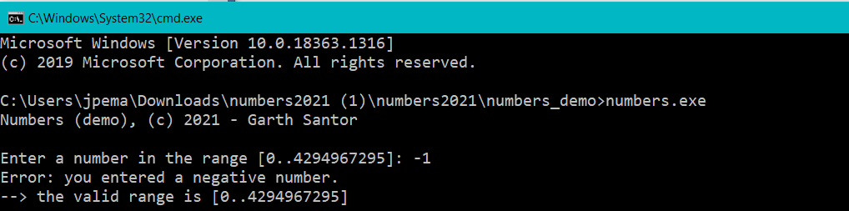
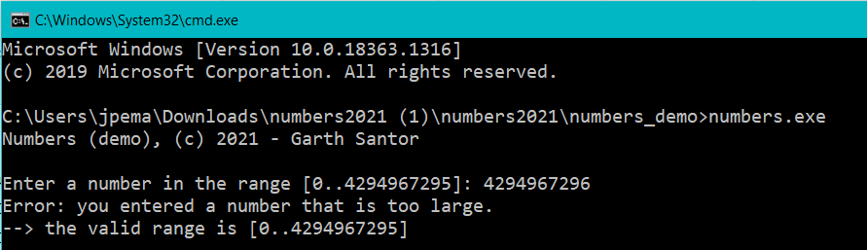
Input Examples
What happens if:
Input is not valid type
Input is outside of min range
Input is outside of max range

Slide 5
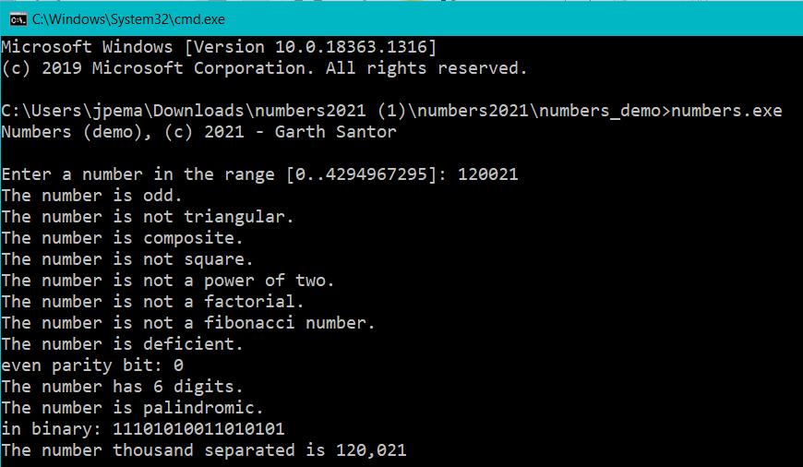
Output Example See report with valid input

Slide 6
Before you begin to code . . .
What should the project be named?
What skills are you expected to demonstrate?
What demo codes have examples of these skills?
What skills do you have to research?
What coding style are you expected to demonstrate?
Where are coding style resources?
Where are submission requirements?

Slide 7
Project 1 – Do you know your numbers?

Slide 8
Do you know your numbers?
A number is a mathematical object used to count, measure, and label. The original examples of numbers are the natural numbers 1, 2, 3, 4, etc.
In mathematics, the idea of a number has been extended to include 0, negative numbers, rational numbers, real numbers, and complex numbers.

Slide 9
Do you know your numbers?
More recently mathematicians began to develop many different abstractions which share certain properties of numbers. For example, a number can be tested to have any these properties:
Even and odd numbers
Triangular number
Prime and composite numbers
Square number
Power of two
Factorial number
A Fibonacci number
Perfect, deficient, or abundant number

Slide 10
Further examples of reports about a number include:
Even parity bit
Number of digits
Palindromic digits
Binary representation
Decimal representation with thousands separators

